Slide 1
1
Course code : ( CSE - 3104 )
Course Title : Software Engineering Laboratory
Project Title : City Care
Team Member
Advisor
Sheikh Naim Hossain
Zahrul Jannat Peya
ID - 20232043010
Assistant Professor
Shourav Bachhar
ID - 20232061010
Department of CSE,
North Western University ,
Khulna
Shamsul Haque Shuvo
ID - 20232063010

Slide 2

INTRODUCTION
2
City Care Software is an advanced hospital management system designed to simplify and digitalize daily healthcare operations. It provides an all-in-one platform that connects patients, doctors, and administrators through a user-friendly interface. The system enables efficient appointment booking, patient record management, doctor scheduling, billing, and report generation all in real time.

Slide 3
3
KEY CONCEPTS IN CITY CARE
Login
Home
About
Blog
Doctors
Appoinment
Payment

Slide 4
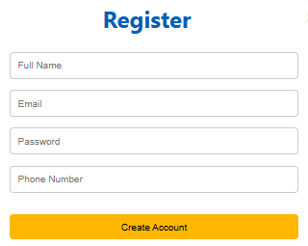
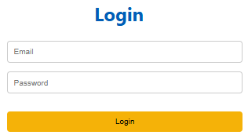
USER LOGIN SECTION
4

Slide 5
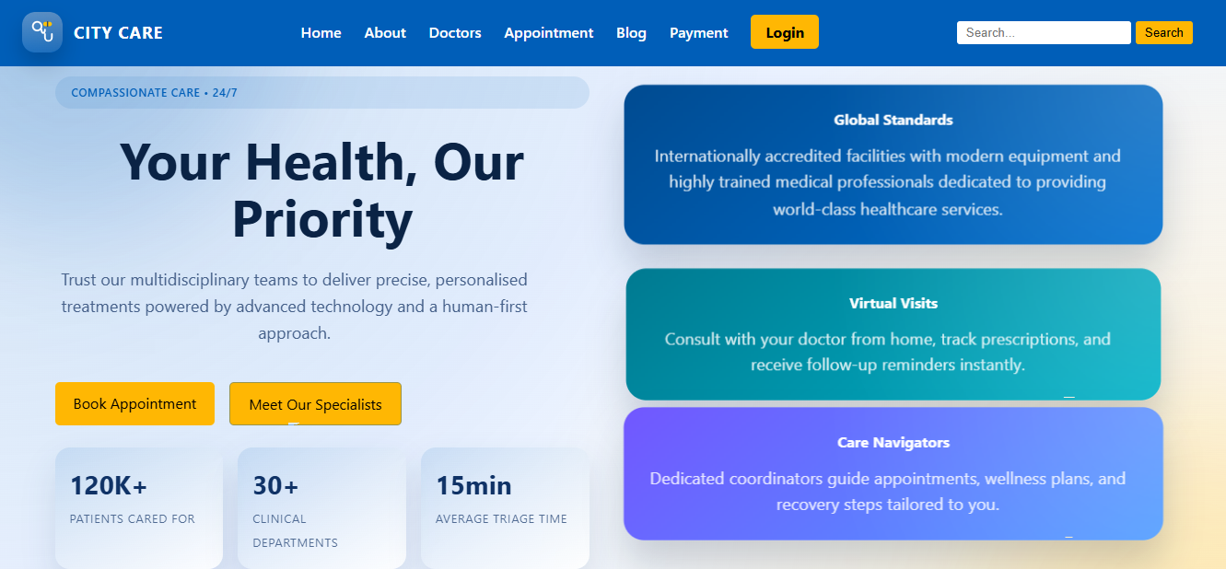
5
HOME PAGE

Slide 6
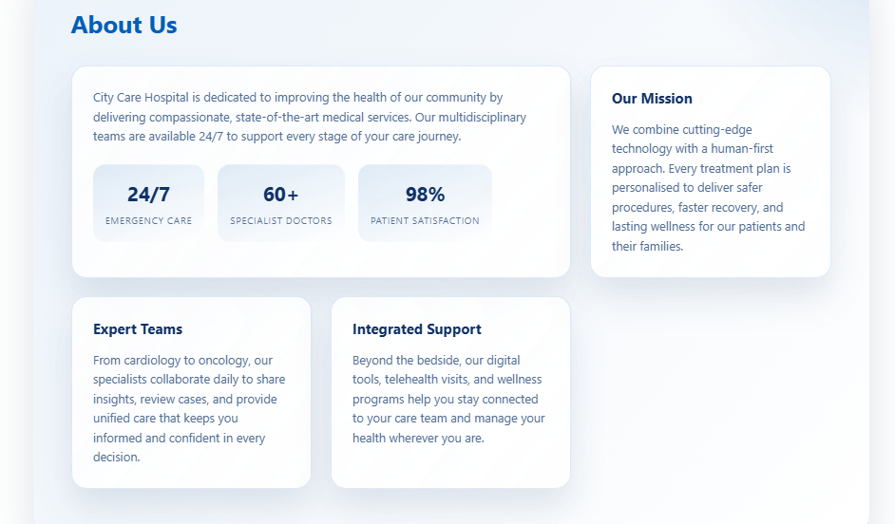
6
ABOUT

Slide 7
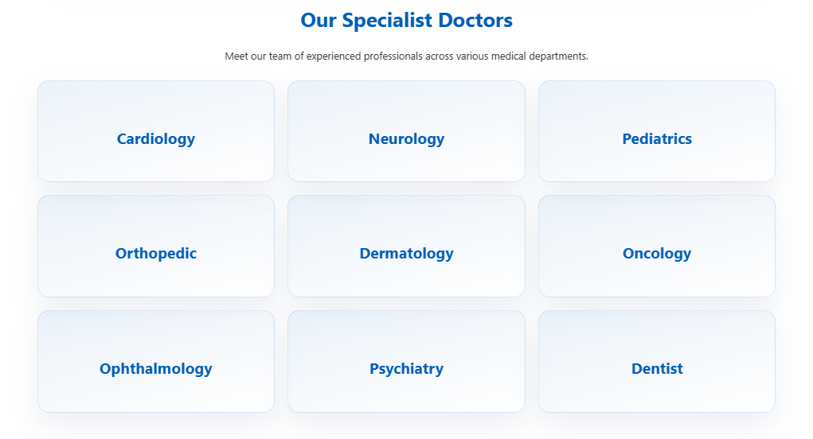
DOCTORS SECTION
7

Slide 8
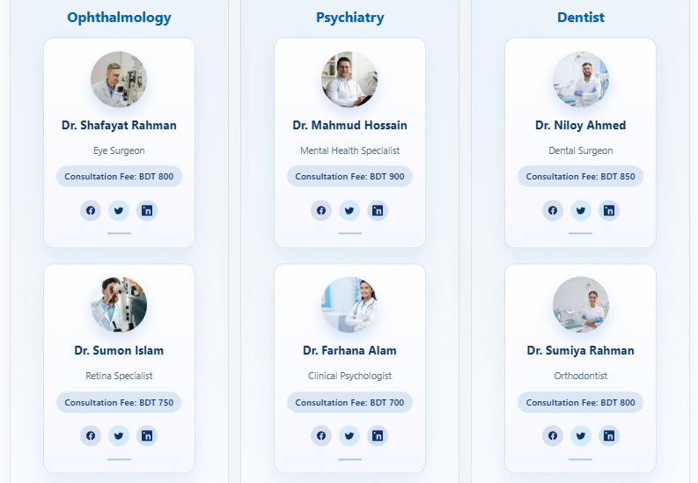
8
DOCTORS PROFILES

Slide 9
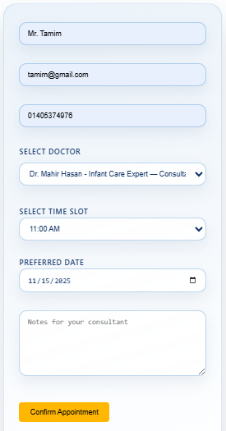
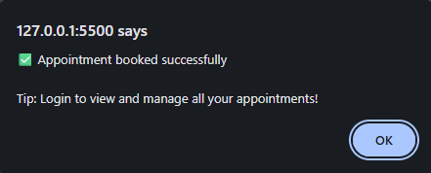


BOOK AN APPOINTMENT
9

Slide 10
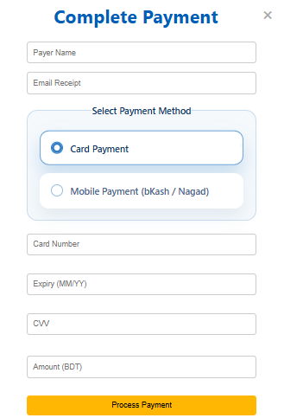
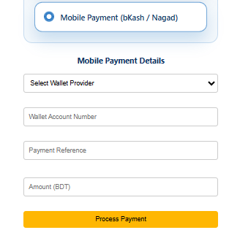
PAYMENT SECTION
10

Slide 11
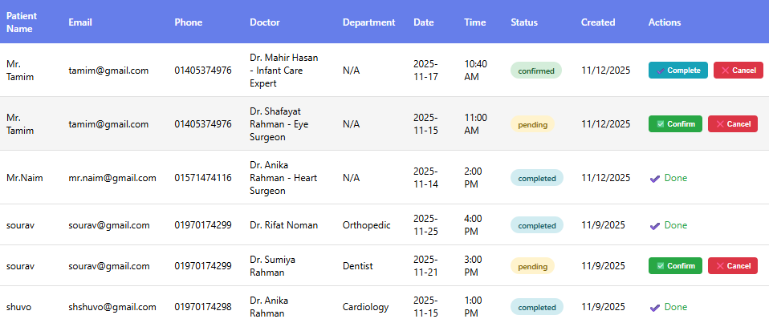
11
ADMIN SECTION

Slide 12
12
CONCLUSION
The City Care Hospital Software provides a complete and reliable solution for managing hospital operations efficiently. It brings together patients, doctors, and administrators on a single digital platform, ensuring better coordination and faster healthcare services.

Slide 13
THANK YOU

